Slide 1
iScala Epicor Användarförening
Henrik Brink Magnus Enochsson
TM Manager Solution Engineer

Slide 2
Safe Harbor Statement
FORWARD-LOOKING STATEMENTS: This Presentation may contain certain statements that may constitute forward-looking statements. These forward-looking statements may include statements regarding future product releases, future functionality, expected revenues, cash flows, growth prospects, installed base of customers, the launch of new products and other statements that are not historical fact. These forward-looking statements are based on currently available competitive, financial and economic data together with management's views and assumptions regarding future events and business performance at the time the statements are made and are subject to risks and uncertainties. Actual results may differ materially from those expressed or implied in the forward-looking statements. Such risks and uncertainties include but are not limited to changes in the demand for Epicor's products; the timely availability and market acceptance of new products and upgrades; the impact of competitive products and pricing; changes in the overall economic and financial condition of our markets or customers; and other factors. As a result of these factors the business or prospects expected by Epicor may not occur. Epicor undertakes no obligation to revise or update publicly any forward-looking statements.

Slide 3
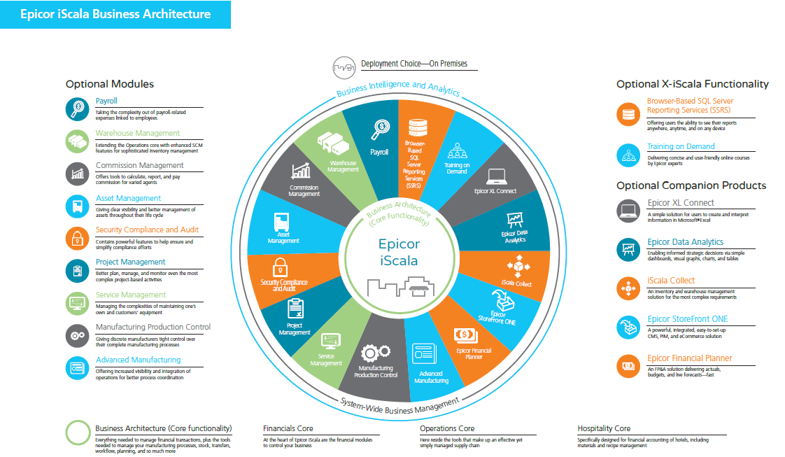
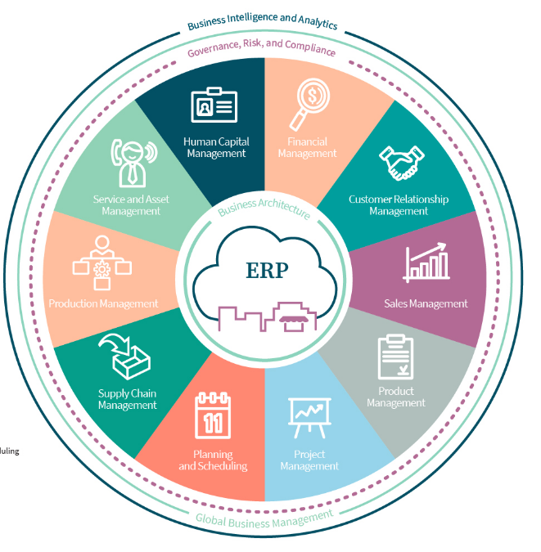

Slide 4
Epicor is Focusing Where You Need Us
Epicor Kinetic ERP Cloud
iScala 3.3
iScala 3.4
iScala 3.5
iScala 2022.1
iScala
On-Premises
Analytics & BI
Online learning
Automation
Analytics & BI
Automation
Global
Global
Performance
Various Customers Enhancements
Document Automation
Enhanced Mobility
Financial Reporting
2019
2020
2021
2022

Slide 5
Customer Choice:
Consider SaaS / Cloud - Smooth path to the Epicor Kinetic ERP
Stay with iScala On-Premise that remains robust and reliable
Migrate to Cloud
Upgrade to the latest iScala release
Notes:
With this approach already today you have a choice, to stay on iScala on premise and continue getting benefits in latest enhancements or start your journey to a cloud ERP.
Why Some iScala Customers Might Migrate to Cloud
iScala may no longer be a complete fit:
Centralization / move to Tier-I system
Changed company structure
Enhanced and flexible scalability requirements
SaaS deployment model
Functionality
Platform and customization
Other business/strategy reasons

Slide 6
iScala Support Lifecycle Stages
Product Release | Release Date | Support Stage | End / Transition Date
iScala 2022.1 | 14/Sep/2022 | Active | Move to Enhanced Sustaining Sep/2024 Move to Sustaining Sep/2025
iScala 3.5 | 24/Mar/2021 | Active | Move to Enhanced Sustaining Mar/2023 Move to Sustaining Mar/2024
iScala 3.4 | 25/Mar/2020 | Enhanced Sustaining | Move to Enhanced Sustaining 25/Mar/2022 Move to Sustaining 25/Mar/2023
iScala 3.3 | 24/April/2019 | Sustaining | Currently in Sustaining
iScala 3.2 | 11/Apr/2018 | Sustaining | Currently in Sustaining
iScala 3.1 | 31/Mar/2017 | Sustaining | Currently in Sustaining
iScala 3.0 | 1/Jul/2016 | Sustaining | Currently in Sustaining
iScala 2.3 SR3 (and earlier) | 6/Dec/2010 | Sustaining | Currently in Sustaining
*Epicor is providing an "Enhanced" Sustaining support experience for a limited time to allow our customers additional time to build a proactive upgrade model and plan for their move to the latest release. Enhanced Sustaining is a transition support level and is not a long-term Lifecycle stage. Enhanced Sustaining includes critical and/or quarterly patches and security fixes, and limited compliance and regulatory updates. Full phone support access, additional module sales and customization and implementation services remain available during Enhanced Sustaining.

Slide 7
Epicor iScala Support Lifecycle
Helping you better plan for your investments and opportunity far into the future.
Service | Active Support Up to 2 years from GA | Sustaining Support 2+ years from GA (no expiration)
Access to Latest Releases* | Yes | Yes
Security Updates** | Yes | Existing Updates Only
Critical Patch Updates** | Yes | Existing Updates Only
Compliance & Regulatory Updates** | Yes | Existing Updates Only
Online Knowledgebase & Content | Yes | Yes
Application & Technical Support Service | Full Access | Online request only
Availability and Response of Application & Technical Support | Standard Service Level Targets and Hours | Potentially Modified Service Level Targets and Hours
New Issue Investigation (Undocumented issues) | Yes | Available for fee
Customization Service | Available for fee | Upgrade Existing Only
Implementation Service | Available for fee | Not available
Purchase Additional Modules | Available | Not available
Purchase Additional Users | Available | Available
* Includes verified compatibility with most new 3rd party current product releases
** Must be on supported operating systems, databases and hardware. All fixes are subject to approval.
*typically within 90 days
Notes:
With that perspective – let’s review the policy in a bit more detail… To be more specific - Epicor is introducing our Software Support Lifecycle commitment to help you better plan for your investments and opportunity far into the future. This commitment provides customers with insight into the level of support available for each release, delivering a simple, predictable, manageable and reliable roadmap to help you plan for change and opportunity. Through this policy, we are striking a balance of enabling you to embrace an accelerated pace of innovation while taking advantage of a solution that can be tailored to your business through customization and configuration. A progressive/proactive approach to managing your Epicor ERP implementation can help you to gain a competitive edge in the marketplace, but if you need the extra time to make your next move, Sustaining Support provides you with a peace of mind that we will be there to support you and your business needs.
This policy is applicable to On Premises deployments as well as Single-Tenant Cloud deployments. In the world of Dedicated or Multitenant Cloud – with Epicor’s assistant – you will remain current on the latest release.
In Active Support – you will receive the full extent of the Epicor Maintenance and Support experience.
In Sustaining – we no longer provide development on your release, although you will continue to have access to existing fixes or the latest release. Additionally – support will move to an Online Incident submission model and hours of availability and service level targets may be reduced. It’s also important to note that to ensure stability of the platform, Epicor no longer provides additional functionality sales or new customization or implementation services for Sustaining releases. Additional users continue to be available for purchase and Epicor will still support existing customizations through Customization Maintenance.

Slide 8
Business Impact Of Upgrading
Gain access to the latest features and improved functionality
Minimize disruption by upgrading more frequently
Stay on the Active Support
Benefit from the latest security features
Allow iScala to help you maintain Competitive Advantage
Notes:
As stated before, there are various reasons to stay current.
At Epicor, we want all our customers to be at the latest release.
And the reasons are simple: it is easier to support you. Instead, we can better focus on helping you to get the most out of the system. This will naturally generate more happy and satisfied customers.
Of the many advantages of staying current, security comes first.
Being current means the most recent and secure Vendor Platforms are supported. This basically means server´s operating systems and patches. Also the latest Security and Governance enhancements are in place. This is important as security normally is a top of mind for most businesses. Staying current minimizes business disruption caused by issues with security.
Security and safety are also something we need to consider while we talk about active support. To stay under active support, you should upgrade frequently.
You can boost your support options by staying current. Any enhancements are prioritized for Actively Supported Customers. Not to mention that any possible fixes are only available for active support.
Upgrading more frequently normally is more straight-forward-process than doing it once for every ten years. A frequent upgrade means you have a process in place. Things are perhaps better documented and the gap between versions is smaller causing less technical issues.
Comparison is small steps vs. giant leaps. The reality is that it is less disruptive for your business and its employees if you choose to stay current.
Having the latest version to play with, means you will get to benefit of all it´s new functionality. With the new now, some of these advanced features and added process automation can be essential for your business.
You might have found work arounds for processes that are not supported by your current technology. By reducing these work arounds, businesses instantly see a benefit in increased productivity.
What does this mean? Standard or out of the box-functionality that comes along with the latest releases. Something that was added to the product as a standard since you had added your work arounds. Epicor does listen. Customers are important part of our product development. Should you feel there is a gap in the functionality, please let us know about it! Along with the new releases we furthermore continue to add new features and functionality. All of the whys I have just mentioned, will help you to maintain your competitive advantage.

Slide 9
Defining the Epicor Support Experience
All support customers receive access to Essential Support:
Unrivalled industry expertise supporting Epicor software and related technologies
Award-winning EpicCare support portal – accessible 24x7
Flexible support for cloud, on-premises, or hybrid solutions
Your choice of local, proven Epicor Partners or 100% Epicor employee resourced analysts
Industry-leading response times for priority 1 cases
Technology and feature advancements through upgrades or migrations to new Epicor platforms
Pro customers will also experience:
The comfort of availability through 24 x 7 support and global support center access
Exceptional levels of case prioritization and resolution
Peace of mind with senior support experts to handle support calls and incidents
Advocacy through scheduled manager meetings
Deeper insights with the Support Experience Dashboard
Notes:
Giving customers the tools they need to take their support experience to the next level
Designed based on customer feedback
Essential support addresses:
Transparency
Consistency
Responsiveness
Self Service
Cloud deployment needs
Meet the needs of the majority
Pro support focuses on two areas:
Extended coverage through days, hours, language, sites/time zones including 24x7 coverage
Advanced services through elevated response/resolution times, resources/skills (Tier 2, Development), knowledge (training, advanced insight), tools (testing, backup, monitoring), and Customer advocacy

Slide 10
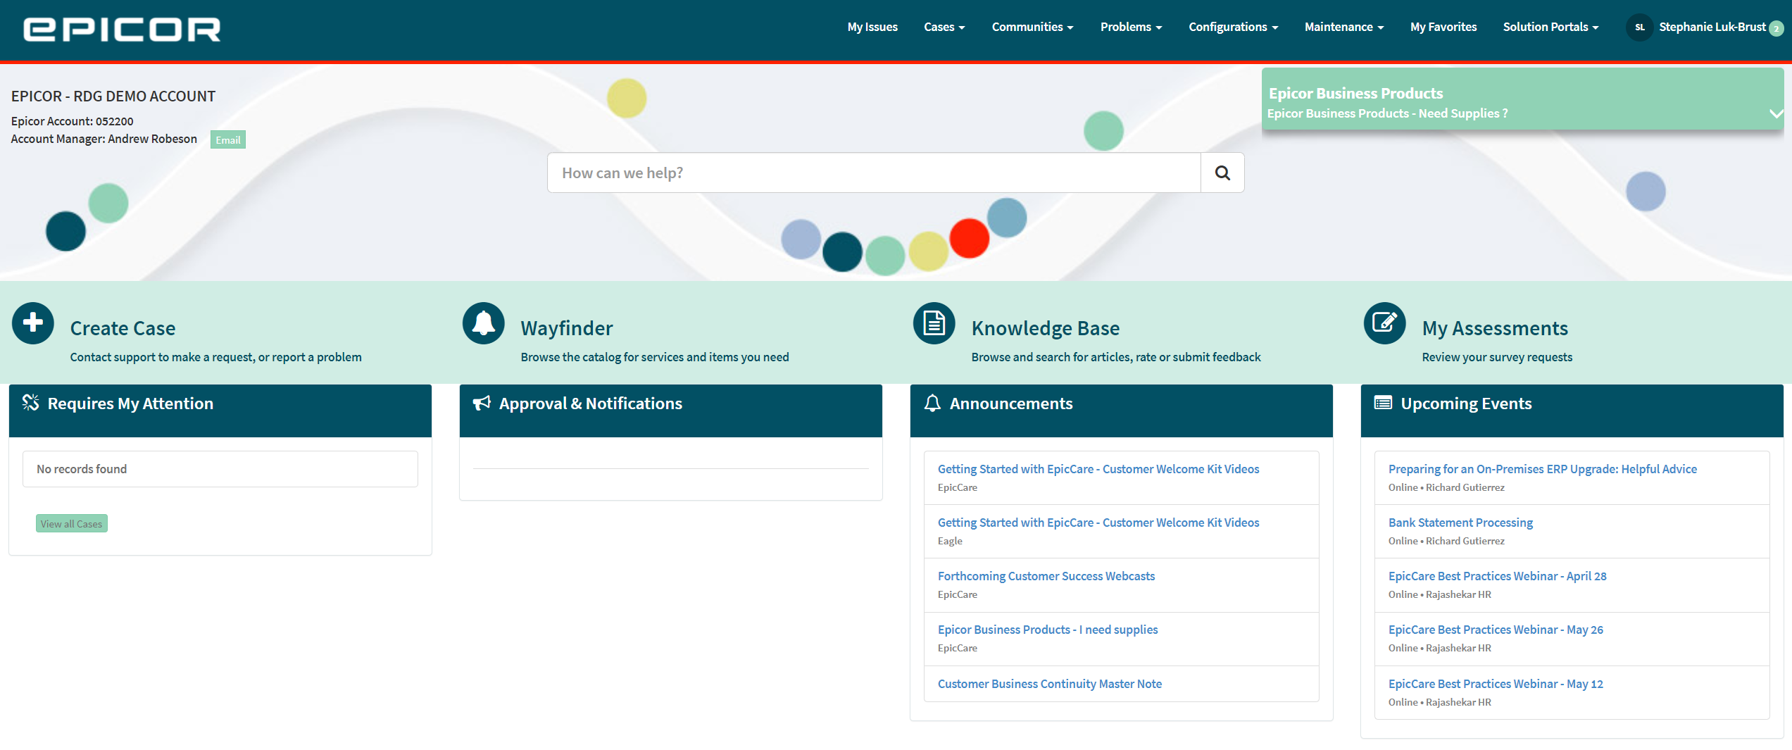
Knowledge at your Fingertips
Global search Search for cases, problems, and Knowledge Base articles
Knowledge Base articles
Browse among the extensive library comprised of articles and videos
Updated nearly daily
Suggest articles and leave feedback
Enter a case 24x7
If you can’t find what you’re looking for in our self-help resources, enter a case directly in EpicCare
Wayfinder A standardized way to manage Epicor non-technical requests

Slide 11
iScala 2022.1, huvudsakliga förbättringarna
1
Finansrapporter
Import/Export av rapportstrukturer, flerspråkiga beskrivningar, beräknade kolumner och rader
2
Automation
Utskrift av journaler i jobb, Job Monitor förbättringar och möjlighet att starta jobb från ESC
3
Prestanda
Möjlighet att använda flera iScala applikationsservrar

Slide 12
iScala Release 2022.1
CFR
Enhancements
Various Customer Enhancements
Performance
Automation
CSF
Multiple iScala Application Servers
Import/Export
Support multilingual descriptions
Calculatable rows and columns
Enable printout of journals in the jobs
Job monitor
Scheduled Creation of Payment Proposals
Control the booking of payments received via the ESC
Multi-company-year bindings for Scheduled Jobs and Business events
Norwegian XML VAT report
QR Invoice, Switzerland
Access restriction to company consolidation account mapping
Strict control when setting Open from Period
SSRS for Sales Order Quotation Template
Attachment dialog improvements
Relax filter restrictions for CJK ideographs
Enhance document tracking archiving
VBA - Extend access to MultiSelectionGrid
12

Slide 13
By Feature code
Feature Code | Feature Name
SCA-15773 | Support multilingual descriptions in CFR
SCA-13271 | CFR, Import/Export
SCA-15810 | Enable printout of journals in the jobs
SCA-16475 | Inherit Report File Name Templates from Company 01
SCA-15722 | Logon dialogs improvements
SCA-15856 | Strict control when setting Open from Period (GL)
SCA-15799 | Scheduled Creation of Payment Proposals
SCA-15804 | Control the booking of payments received via the ESC
SCA-15515 | Tax Registration Country

Slide 15
iScala 3.3
Some of the functional highlights of iScala 3.3
For a fully comprehensive list – please see What's New in iScala 3.3-section on iScala 3.3 Release Notes.

Slide 16
Release highlights for iScala 3.3
1
Improved Reporting and Analytics
iScala Reporting Platform (+ Epicor Data Analytics + XL Connect (Spreadsheet Server)
2
Improved UX/UI
Helping user productivity
3
Staff Up-Skilling - Training/Knowledge on Demand
Short online training courses by the experts
Better user knowledge => effective use of iScala => business efficiency
4
Improved system performance

Slide 17
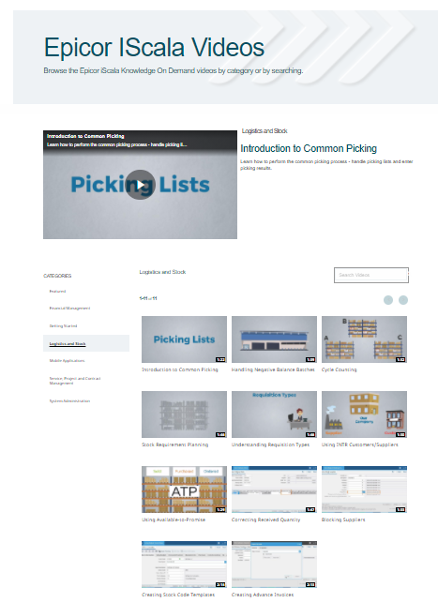
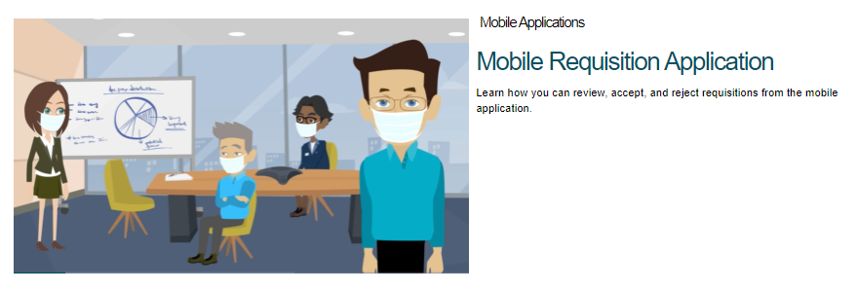
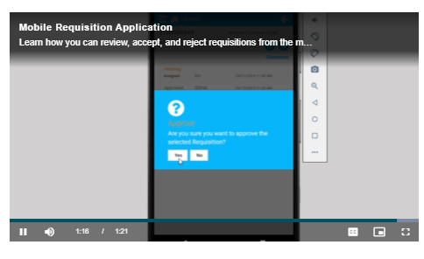
Knowledge On Demand
http://iscalavideo.epicor.com/
Short knowledge videos
Embedded access to videos in iScala 3.3.

Slide 18
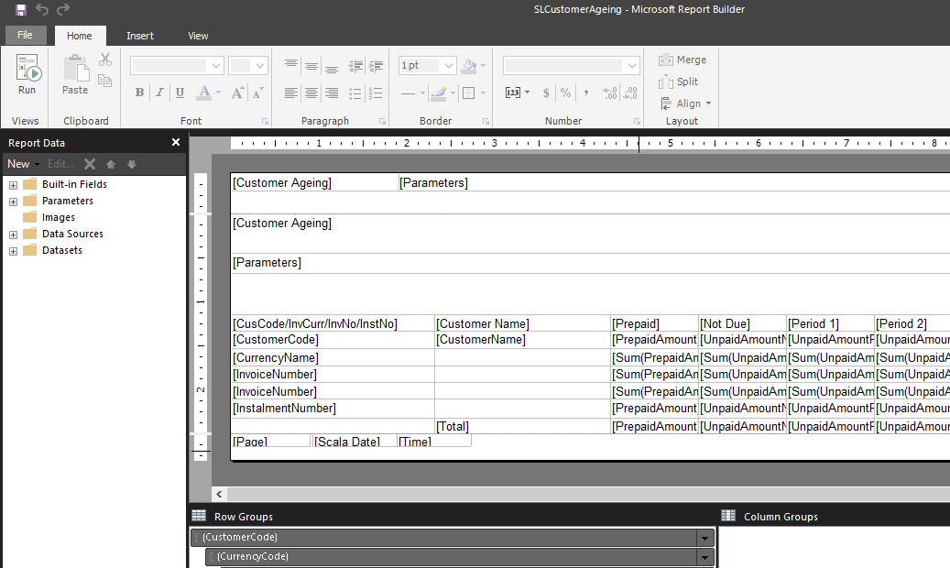
New Reporting Platform
Microsoft SQL Server Reporting Services (SSRS)
Available as:
iScala back-office
Summary messages for customers:
Clear, modern, user-friendly and comprehensive (different modules)
Covers main operations (see later), offering detail and drill-down
Screen view, and save/export to Excel, CSV, PDF etc.
Flexible and customizable (and creation new reports)
SSRS; de-facto reporting model (in future, migrating from DDF/Crystal)
Web-based, via and SSRS portal

Slide 19
New iScala Reporting Platform – Reports Available
General Ledger module
Transaction List
Trial Balance
Stock Control module
Stock Item List
Stock Transaction List
Stock Item Balance
Stock Item Balance Detailed
Stock Movement
Sales Ledger
Customer List
Customer Invoices
SL Transactions
Customer Ageing
Purchase Ledger
Supplier List
Supplier Invoices
PL Transactions
Supplier Ageing
Other
DI Direct Invoice (Print form)
SM WIP Journal

Slide 20
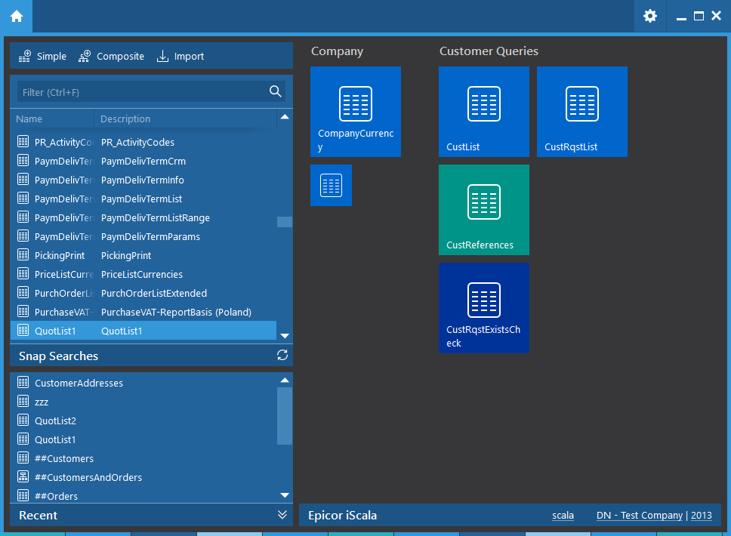
Snap Search UI update
Updated UI in line with iScala
Recently used Snap Searches
Tiles
Toolbar for quick creation of Snap Searches
Tabs for different Snap Searches
Quick change of companies
Toolbar in Snap Search builder (Export, sorting, columns etc)

Slide 21
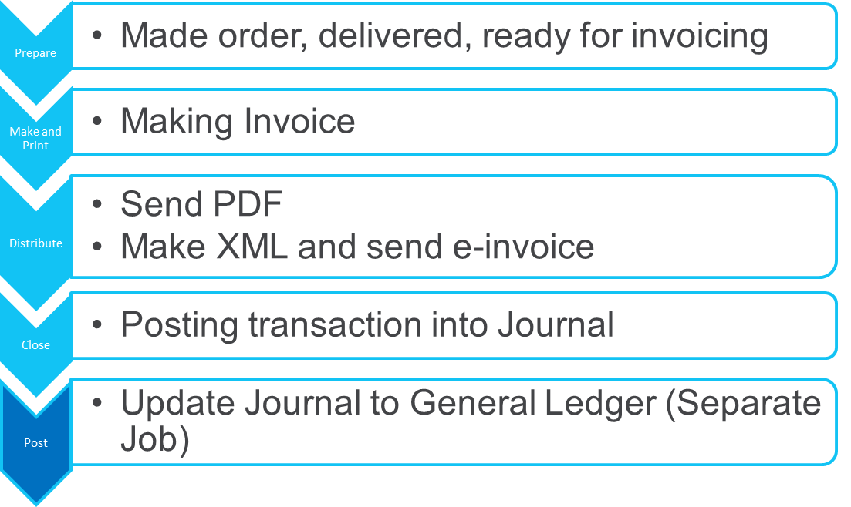
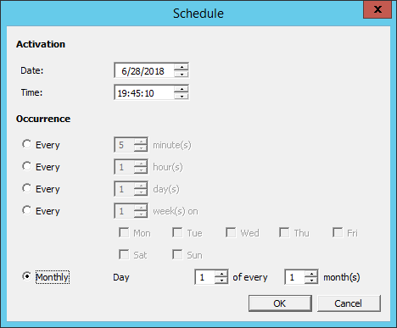
Automated invoicing and closing
Automatically executing monotonous and well-established processes.
It is wrapped up as iScala Jobs: processes ran by schedule.

Slide 22
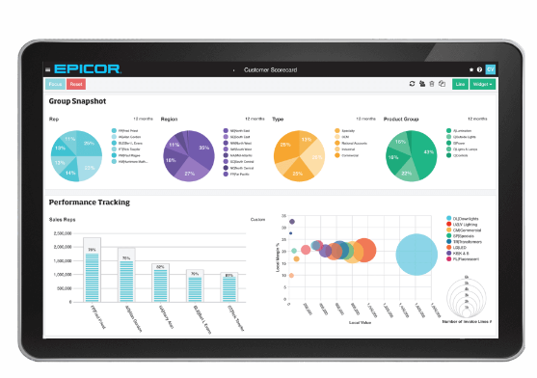
EDA for iScala
Epicor Data Analytics for iScala is a Business Intelligence product for data analysis:
Web-based tool
Allows to analyze data in grid, pivot- and chart-views
Dashboards and Alerts
Drill-down to transaction data
Good selection opportunity
Modeling of data relations on-the-fly
SaaS (based on subscription) and On-Premise (Perpetual license) models
Notes:
We’ll just reference EDA here, since it is being launched at the same time, albeit separately
EDA fits into the reporting story that will help us in the effort to try and get customers current – but more of that later.

Slide 23
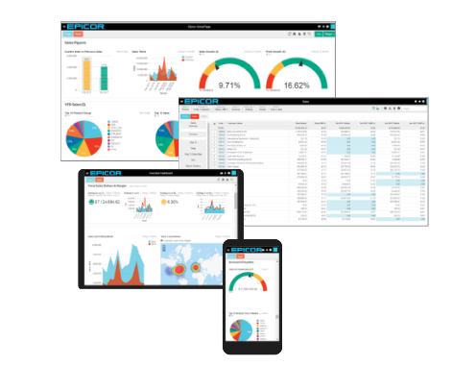
Epicor Data Analytics Integrates
iScala

Slide 24
iScala 3.4
Some of the functional highlights of iScala 3.4
For a fully comprehensive list – please see What's New in iScala 3.4-section on iScala 3.4 Release Notes.

Slide 25
The Five Most Valuable Enhancements
1
BI and Reporting
iScala Financial Reporting and New out of the box reports and printing forms
2
Mobility
New Service Management Mobile and various enhancement in existing mobile apps
3
Automation – Document printing
Replacement of obsolete Print Monitor with a new engine to automate printing
4
Security – Audit extension
Audit tool extension to operation data: sales and purchase orders
5
Data Navigation
Snap Search extension to improve usability

Slide 26
Financial Reporting
In-built financial reports
Instead of external instruments (FRx, Mgmt Reporter, AFR, HRT)
Available in back-office and in Web
Flexible and powerful configuration
Additional data structures (Groups of accounts, Balance type, Categories)
Can be used by External report engines (e.g. EDA)

Slide 27
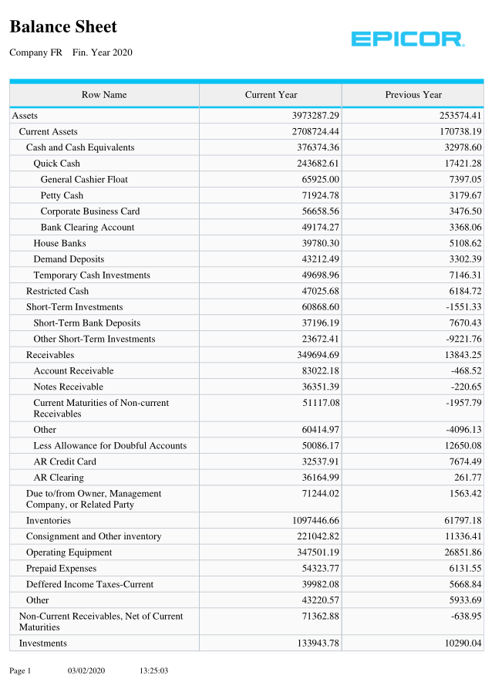
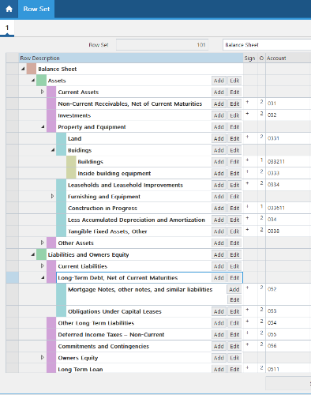
Financial Reporting
Reports:
Operating Statements
Income Statement
Balance Sheet
Cash Flow Statement

Slide 28
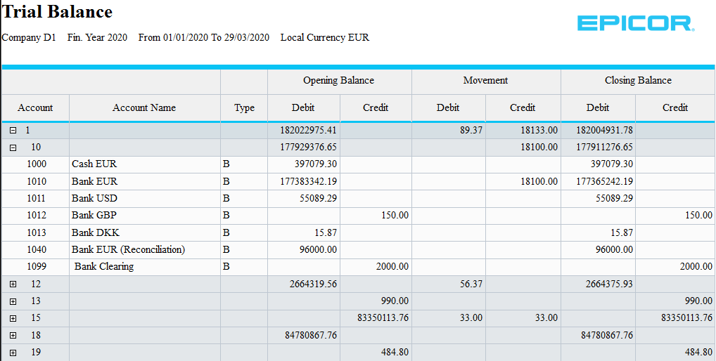
Reporting 1/2
iScala Reporting Platform (iRP)
Introduced in iScala 3.3
Unified reporting with single approach for any report type
Based on well known platform - SQL Reporting Services (SSRS)
Benefits for you
Reports are fully customizable
You can create your own
iScala languages are respected
Data reports are reachable from web browser
40 reports already made for iScala 3.4 and more will come

Slide 29
Reporting 2/2
Configurable Financial Reports
In-built feature, replacement of General Ledger Report Generator
Lite version of AFR, FRx or similar tools
Row & Column definition concept
Designed for financial and operating reports, such as:
Operating Statements
Income Statement
Balance Sheet
Cash Flow Statement

Slide 30
New SSRS Reports available

Slide 31
Autonomous Document Printing - Reworked
Monitors printing queue
Print Monitor
Client
User
Server
Requests to print a document
Document printing jobs
Paper (PDF) documents
ESC Print Request Manager
Job Queue

Slide 32
Autonomous Document Printing - Documents
Document
Generic Sales Invoices (Sales Order Management, Service Management, Contract Management, Project Management, Sales Ledger)
Goods Receive Notes
Delivery Notes (Sales Order management)
Delivery Note (common)
Order Confirmation
Reports
Product Labels (Purchase Control)
Product Labels (Sales Order Management)
Bin Labels
Stock Labels
Box Labels
Box Contents
And any other iScala Reporting Platform reports

Slide 33
Automation
Continued increase of Unattended Jobs – Server side, scheduled processing
Process SRP/MRP calculation
Process auto-posting of all journals
Process auto-print* of invoices from all relevant modules
Process auto-print* of inbuilt and user-created SSRS reports
Process auto-print* of other reports, such as OR Delivery note
Autonomous Document Printing via Epicor Service Connect calls redesigned
Print monitor is now Server-side and Monitors, not Executes
Supports printing* of SSRS reports
* Actual action (Print, E-mail or Save) is driven by Output channel.

Slide 34
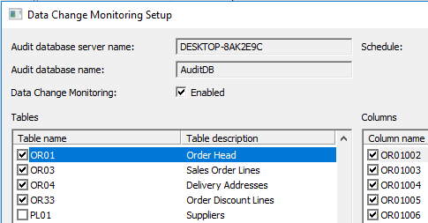
Enhanced Audit Trail
Part of Security and Governance Value Pack-license
In 3.4:
Sales Order
Purchase Order
Stock Item Lifecycle

Slide 35
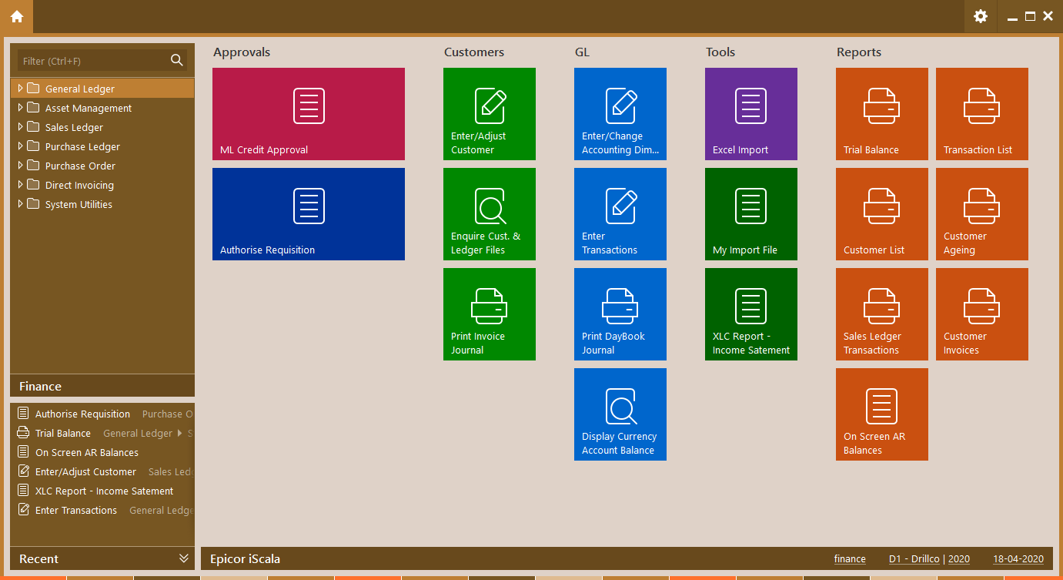
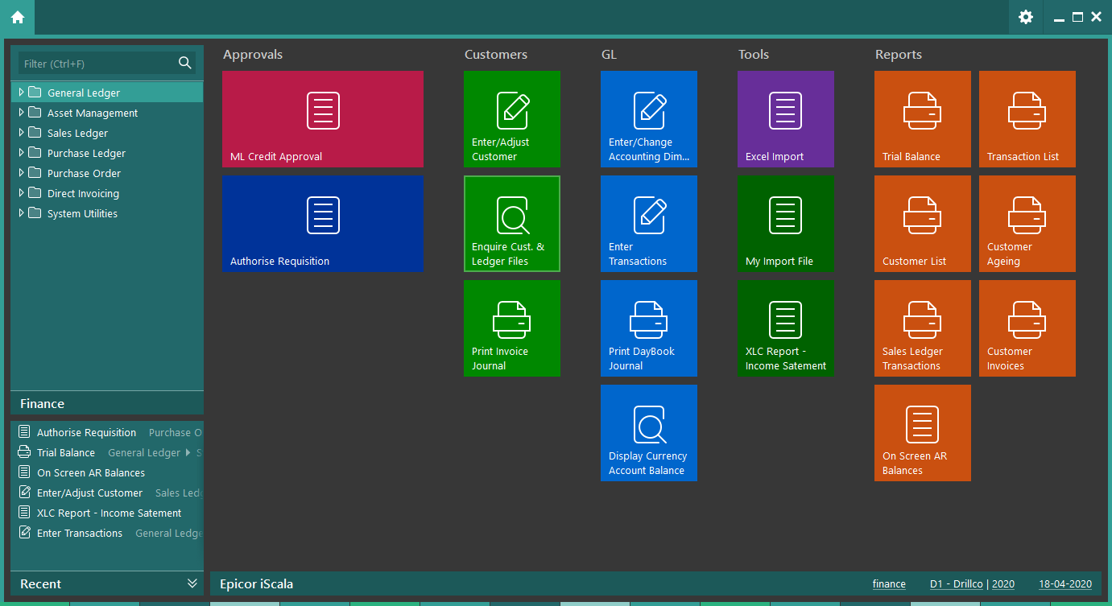
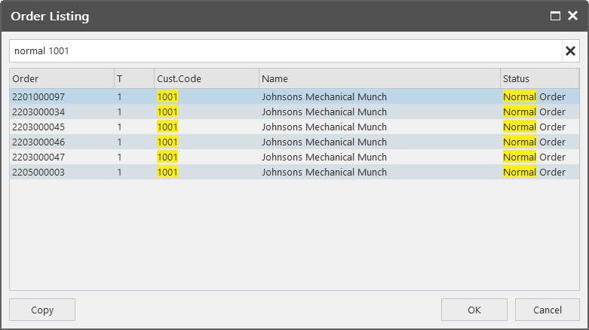
Usability
Continued improvement of user experience
New colour schemes
Better navigation through Multi-Company with Company and Fiscal Year user specific color scheme
Searchable results of inbuilt & custom queries (Snap Search)
Easier navigation through large lists
Snap Search Builder uplifted
Easier to work with
Easier to navigate through fields and tables

Slide 36
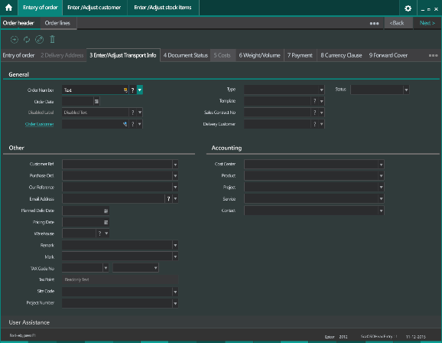
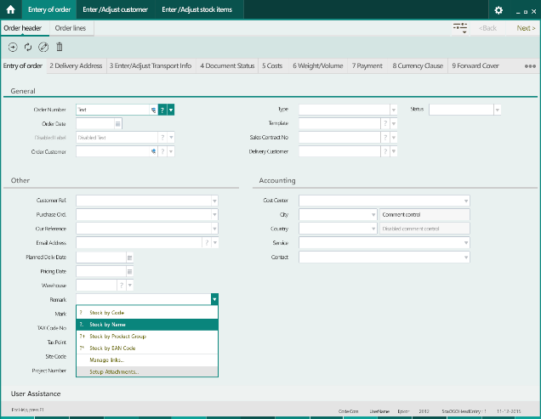
New Color Schemes
Teal and Orange
Users can:
Link Color Scheme to company
Link Color Scheme to Company + Financial Year

Slide 37
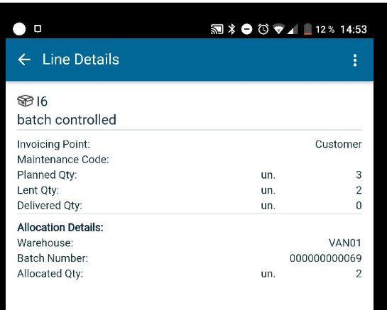
Mobility in iScala
Current mobile applications in iScala:
iScala Warehouse Manager
Manages operations in Warehouse (receiving, delivering, picking, stock taking, transferring)
iScala Sales Manager
Mobile Sales
iScala Requisition Approval
Approve of Purchase Requests
iScala Service Management

Slide 38
Mobility
Service App
Sales Order App
Requisition App
Warehouse App
Summary of orders
Add new or search
The last 3 modified orders
Quick actions
Open
Submit
Assigning/de-assigning service
Orders and activities
Creating new orders/new activities
Working with a service order Provides several key metrics and trackers
Requests for authorization
Search in iScala
Number
Department Code
Department Name
Approve
Reject
Add Comments
Stock taking
Stock receipt
Stock transfer from one warehouse
to another
Querying of the stock items
38

Slide 39
Improvements in Snap Search Builder and Snap Searches
Tables in tree-style:
Field areas, importance and frequency of use
Filtering of table name and groups
Column Explorer
Filtering of Query Results

Slide 40
Bank Statement Process enhancement
The support for receive and process statements (CAMT53) and notifications (CAMT54) was introduced by iScala 3.0 FSP3.
Several proposals for improvement of the processing have been raised:
Adding the possibility to specify a filter linked to the template.
Introducing new columns available for inclusion in the grid.
Introducing new commands and target modules.
Extending the scope of the split (S) command.
Changing the logic with respect to existing features and settings.
Changing the behaviour of some fields e.g. GL bank account.
Introducing amount validation which is enabled by a new parameter of the GL-setup.
Introducing a toolbar where each command has a dedicated button.

Slide 41
iScala 3.5

Slide 42
Release highlights for iScala 3.5
1
SSRS Reporting
New SSRS reports, Enhancements for related Tools
2
Financial Reporting
Significant usability improvements in Configurable Financial Reporting
3
Mobility
Various enhancement in Service Management mobile and Warehouse Management
4
Localizations
Several country specific features to support local legislations, including CAMT 54
5
Compatibility
Support of new releases of Microsoft and other 3rd party products

Slide 43
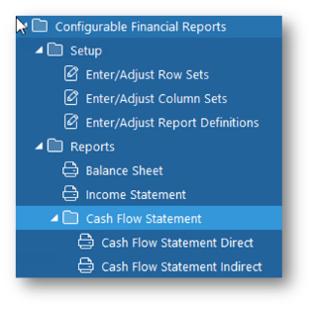
Financial Reporting
Introduced on iScala 3.4, enchanged on 3.5
Replaces Report Generator
Visual designer, drill down, export to Excel
Easy to build financial reports
Drill down to tositteille (in 3.5)
Account/Dimension security
Out of the box available templates (in 3.5):
Income Statement
Balance Sheet
Cash Flow Statement (direct)
Cash Flow Statement (indirect)
Part of Core License

Slide 44
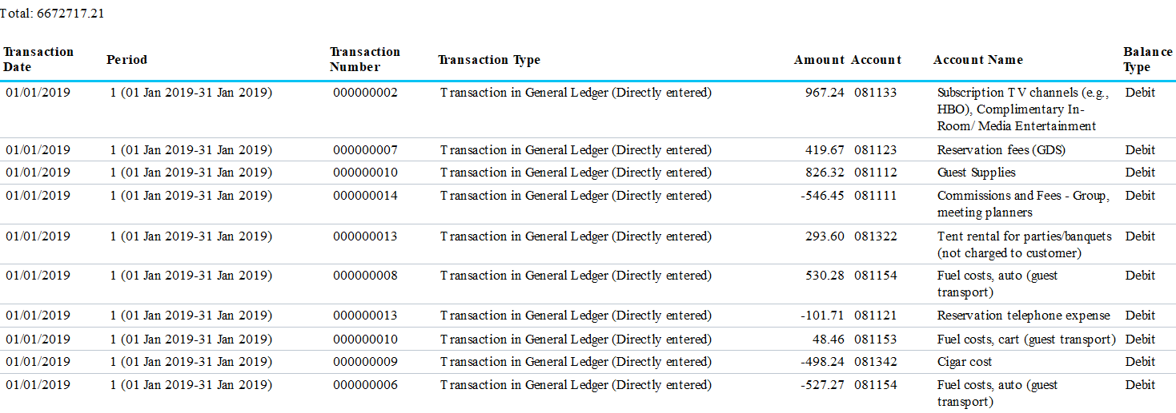
Drilldown Support
…

Slide 45
New SSRS reports available on iScala 3.5
Customer Discrepancy Report​
The report works in the direction from invoices and payments to the expected accounting transactions.
Account Receivable Discrepancy Report​
The report works in the direction from the accounting to the invoices and payment.
Credit Status Report​
The content of the report depends on the configuration of the credit control. The amounts selected to be included to the utilized amount are shown by the report.
It is possible to drill down to view the contribution from the individual invoices, orders, contracts and projects.
Notes:
Customer Discrepancy Report​
The report works in the direction from invoices and payments to the expected accounting transactions. ​
The remaining amount of the invoice is compared with the amount booked to the A/R.​
The differences (if any) are reported as discrepancies.​
Example of discrepancies: Journal is not posted, payments are received via ESC without the creation of GL transactions, multiple due date invoices created prior 3.5. ​
Account Receivable Discrepancy Report​
The report works in the direction from the accounting to the invoices and payment. ​
The amount booked to the A/R is compared with the remaining amount of the invoice. ​
The differences (if any) are reported as discrepancies.​
Example of discrepancies: multiple due date invoice created prior 3.5. Payments are received via ESC without the creation of GL transactions. Loss of transaction after the ledger record is adjusted.​
Credit Status Report​
The content of the report depends on the configuration of the credit control. The amounts selected to be included to the utilized amount are shown by the report. ​
It is possible to drill down to view the contribution from the individual invoices, orders, contracts and projects.

Slide 46
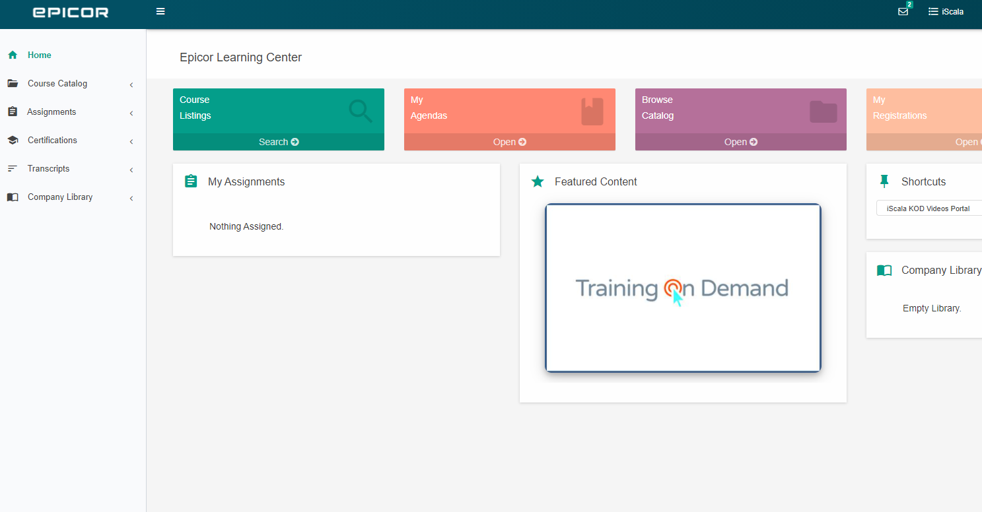
Epicor Learning Center
More than 100 interactive video and written courses
Complete coverage of iScala functionality
Applicable for all customers on any iScala version
Advanced Tax Engine: Setup and Tax Calculation in Orders and Invoices - Part 1
Advanced Tax Engine: Setup and Tax Calculation in Orders and Invoices - Part 2
Installation and Administration of SSRS - Part 1
Installation and Administration of SSRS - Part 2
Advanced Tax Engine: Tax Calculation Algorithms, Exemptions, and Rate Rules
Introduction into iScala System
Basic Workflow in iScala Modules – Setup
Basic Workflow in iScala Modules – Purchasing
Entering and Enquiring Stock Items
Automatic Import from Excel, CSV via ESC - Part 1
Automatic Import from Excel, CSV via ESC - Part 2
Basic Workflow in iScala Modules – Sales and Reporting
Withholding Tax Calculation in Standard Tax Engine
Stock Valuation Methods Overview
Bank Reconciliation
Running SSRS Reports
User Defined Databases (UDDB) Basic
Creating Custom SSRS Reports – Part 1
Creating Custom SSRS Reports – Part 2
SEPA Direct Debit Payments
Compound Periodic Allocations
Intrastat in Sales and Purchasing
Entering a Credit Note Manually
Entering a Customer
Enquiring Customer Details
Invoice-based Intrastat and Stock Transfers
Saving and Restoring Local Company Backup
Common Picking Setup
Using Common Picking
Periodic Allocation for Purchase Costs and Line Quantities
Entering Purchase Prices
Sales Price List
Serial Numbers
Petty Cash Module
Snap Search Builder Basics - Part 1
Snap Search Builder Basics - Part 2
Snap Search Builder Basics - Advanced
Entering a Sales Invoice Manually
Financial Reporting
Payment Forecast in PL
Stock Receipt / Stock Issue
Entering a Payment Manually
Revaluation Concept
General Settings of Company
Asset Reports
Balance Reports
Entering a Warehouse
Batch Information
Bill of Material (BOM)
Stock Taking
Introduction to iScala Administration
Depreciating Assets
Delivering and Invoicing a Purchase Order
Discounts
Documents

Slide 47
Tack !

